Slide 1
Setting up a Tsunami Simulation in Thetis

Slide 3
Pre-processing
Create Mesh
Create the Initial Elevation
Create the Boundary Function

Slide 4
Pre-processing : Create Mesh
Create the Shape Files.
Coastlines
Coastlines can be obtained from GSSHG (Global Self-consistent, Hierarchical, High-resolution Geography)
Boundaries
The boundary should be chosen as that the bathymetry is deep enough in comparison to the horizontal scale of the domain.

Slide 5
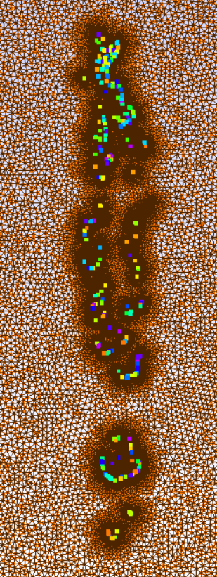
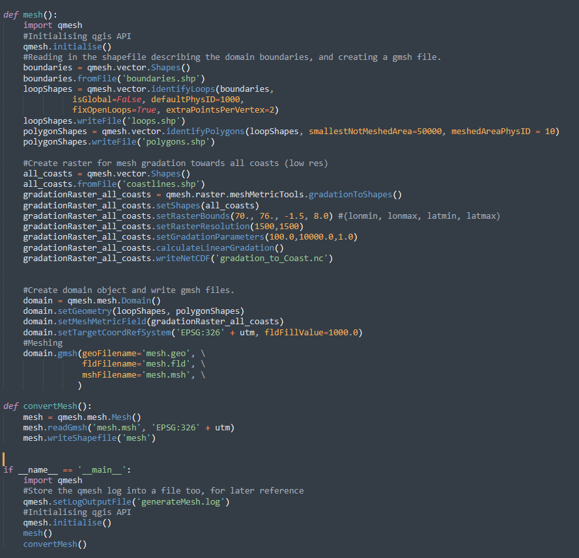
Pre-processing : Mesh Creation
Define the Coastlines and Boundary Shape Files.
Define raster bounds (min.longitude,max.longitude,min.latitude,max.latitude).
Define the resolution of the raster (increasing improves the mesh but takes more time to mesh).
Set the gradation parameters (min to maximum)
qmesh allows us to save the mesh as a shape file which allows us to visualize the mesh in qgis.

Slide 6
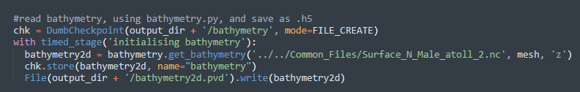
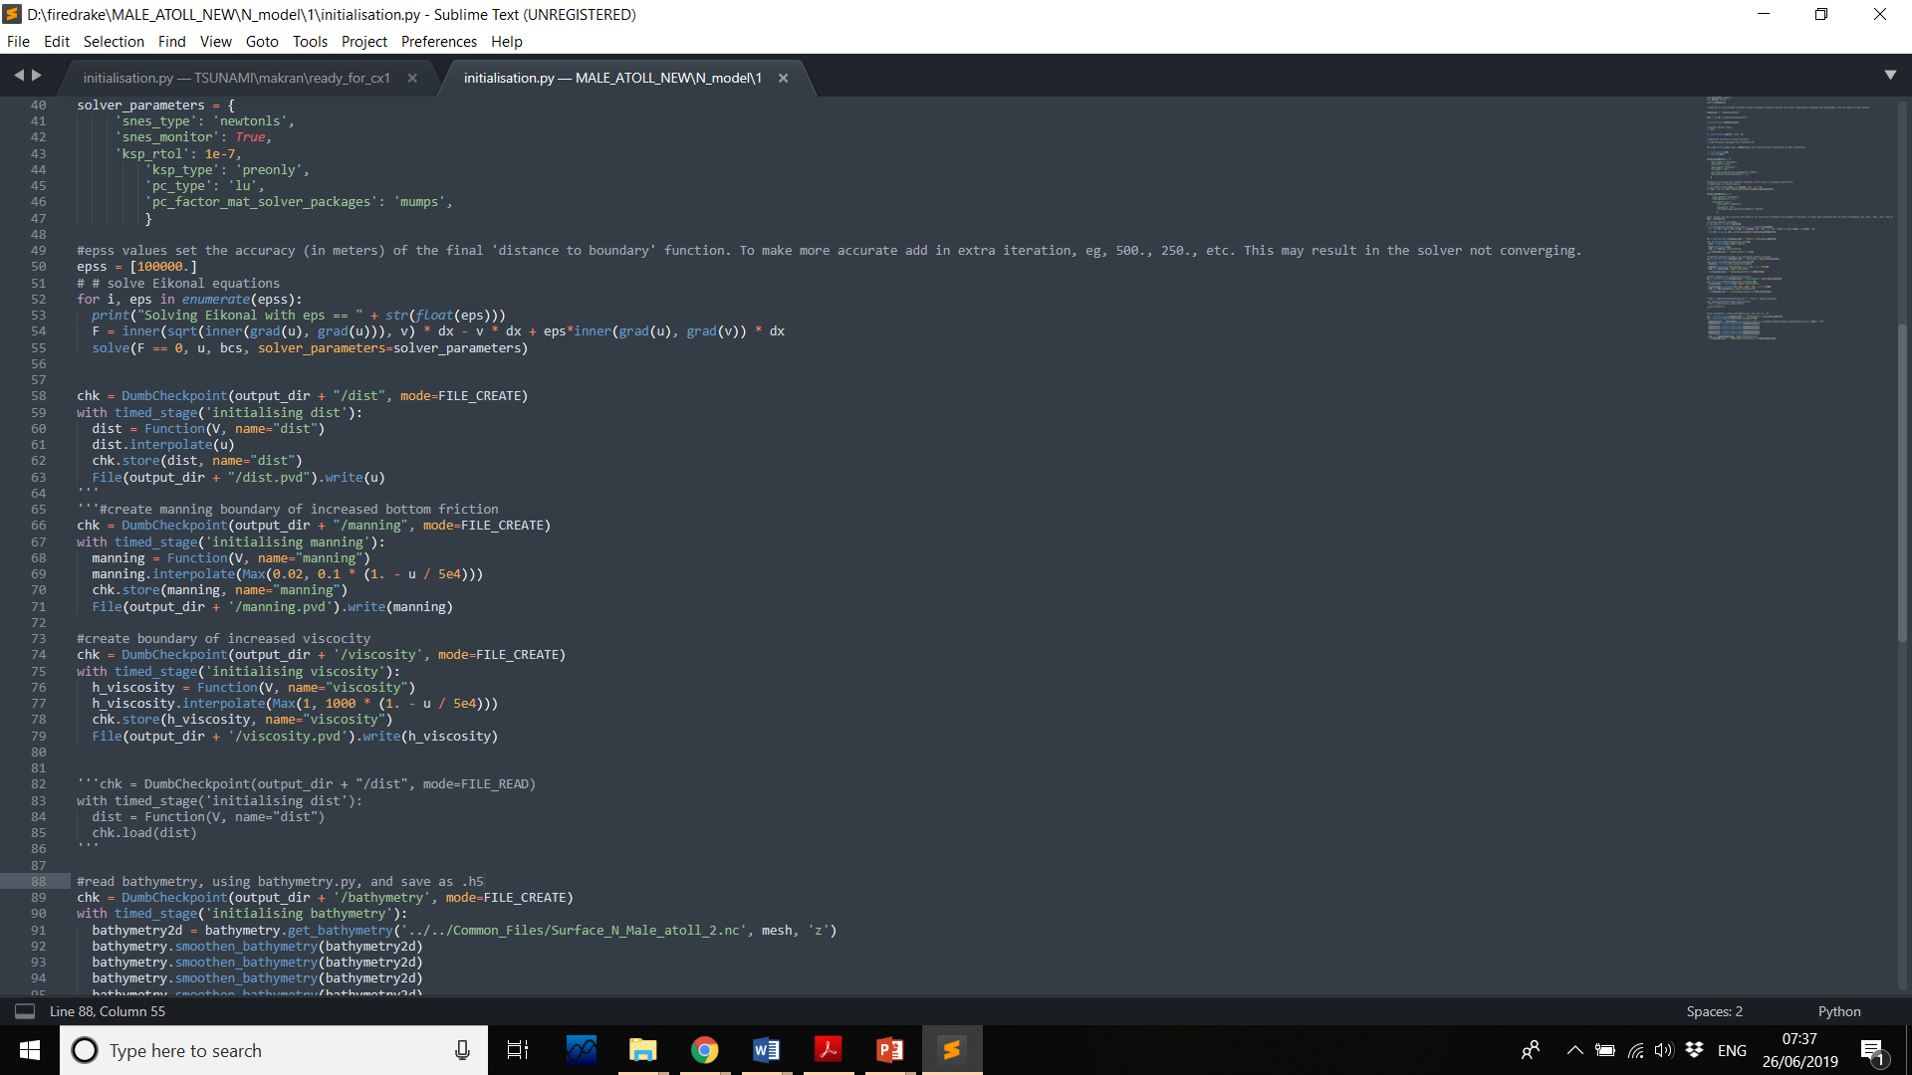
Pre-processing : Bathymetry and Boundary Functions
There are several global bathymetry datasets available, including GEBCO which provides Global bathymetry data at a resolution of 30arc seconds. We use the bathymetry NetCDF file and convert to a hdf5 file which would later be loaded in the model as the bathymetry function.
Next we define the manning roughness coefficient and the viscosity across the domain. Increased viscosity is applied at the open boundaries. These values can be tuned to best suit the model.

Slide 7
Pre-processing : Initial Elevation
To initiate a tsunami from an earthquake, it is necessary to generate a model of how the seafloor moves.
This is often done by starting with a description of an earthquake fault, broken up into a collection of sub faults, with various parameters defined on each sub fault.
For tsunami modeling all we need to know is the motion of the seafloor, which is one boundary of the seismic domain.
It is often sufficient to use the “Okada model” which gives the final deformation of the sea floor due to specified slip on each subfault.
Fault data are available from a variety of sources including USGS.

Slide 8
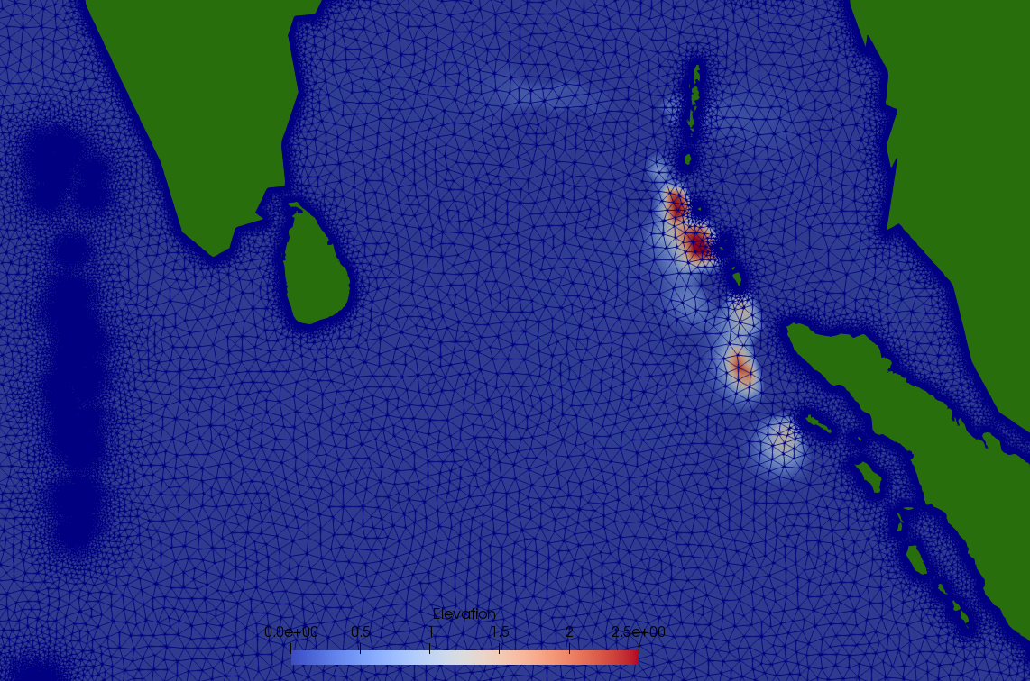
Pre-processing : Initial Elevation
Lat | Lon | Depth[km] | Slip[cm] | Rake | Strike | Dip | L[m] | W[m] | Rupture time(s)
2.22 | 95.33 | 10 | 2110 | 90 | 340 | 10 | 100000 | 100000 | 0
3.14 | 95.14 | 10 | 0 | 90 | 340 | 10 | 160000 | 100000 | 1
4.27 | 94.15 | 10 | 2290 | 90 | 340 | 10 | 150000 | 90000 | 1
5.44 | 93.48 | 10 | 420 | 90 | 340 | 10 | 150000 | 100000 | 3
6 | 94.34 | 27 | 960 | 90 | 340 | 10 | 150000 | 100000 | 3
6.52 | 92.56 | 5 | 510 | 90 | 340 | 10 | 150000 | 100000 | 5
7.08 | 93.42 | 22 | 0 | 90 | 340 | 10 | 150000 | 100000 | 5
8.1 | 92.28 | 5 | 1120 | 90 | 340 | 10 | 150000 | 100000 | 7
8.26 | 93.14 | 22 | 1390 | 90 | 340 | 10 | 150000 | 100000 | 7
9.37 | 92.24 | 10 | 1450 | 90 | 340 | 10 | 100000 | 110000 | 8
10.27 | 92.05 | 10 | 730 | 90 | 340 | 3 | 150000 | 110000 | 10
12.21 | 92 | 5 | 110 | 90 | 10 | 17 | 100000 | 1125000 | 12
The fault parameters are used to generate the initial elevation conditions for our Tsunami model. These elevations can be generated through various tools.
Similar to the bathymetry the elevations are then interpolated on to a firedrake mesh and stored as hdf5 files for input.

Slide 9
Configuring Thetis
Loading the Bathymetry
Loading the Boundary functions
Accounting for the Coriolis effect
Add detectors
Add the Boundary and Initial Conditions

Slide 10
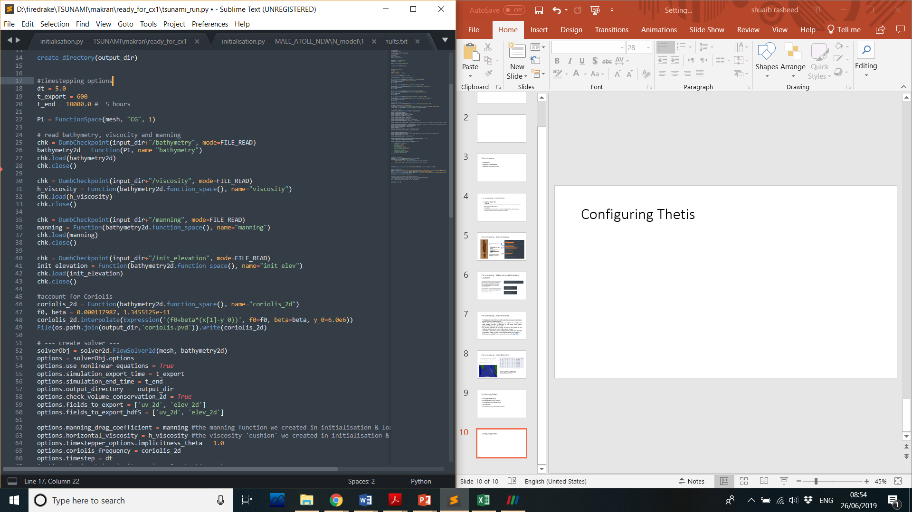
Configuring Thetis
We load the bathymetry, viscosity and the manning functions that we created and stored earlier in the pre-processing stage.
Next we account for the Coriolis effect in the model.
We load the initial elevation that we got from the sub faults. Note that we can load the elevations in several stages according to the rupture time into the model for a more realistic effect.

Slide 11
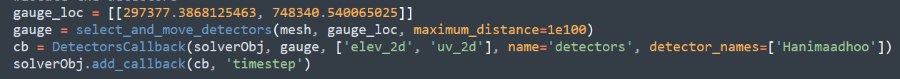
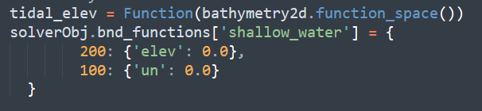
Configuring Thetis
We can place detectors or gauges within our mesh which will record the fields. These can then be compared to physically measured data. Here we add gauges at Hulhumale, Gan and Hanimadhoo.
Next we add the boundary conditions, for open boundaries we set the elevations to zero and for the closed boundaries we set zero velocities. Here the coastlines and the boundaries that we defined in mesh generation are respectively the closed and open boundaries.

Slide 12
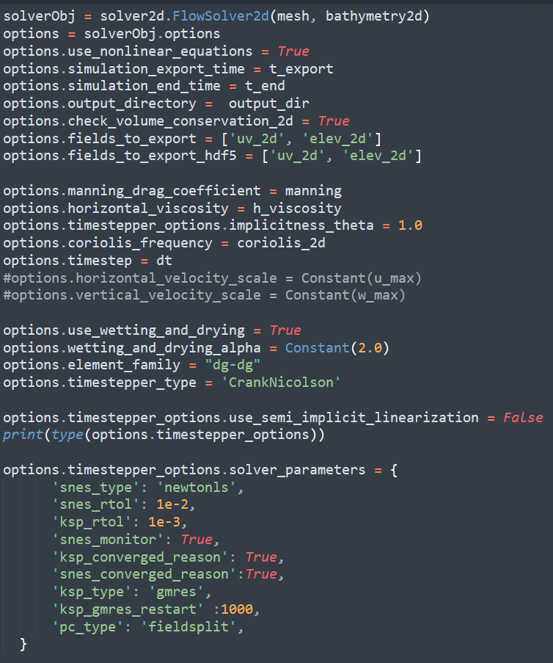
Configuring Thetis

